Slide 1
Concept Presentation
Amanda Grissom

Slide 2
Trifles
by Susan Glaspell

Slide 3
Thematic Statement
In Trifles by Susan Glaspell, Glaspell addresses the topic of female worth; she demonstrates that while women and their concerns are often viewed as trivial, they are both more vital than they appear.

Slide 4
Central Production Metaphor
Easy to overlook
Beneath the weight of seemingly bigger and more important things
Sharp, and able to draw blood when uncovered
Cold to the touch
Trifles is a small, metal needle at the bottom of a full sewing basket.

Slide 5
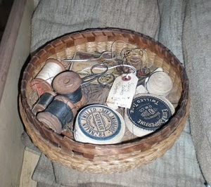
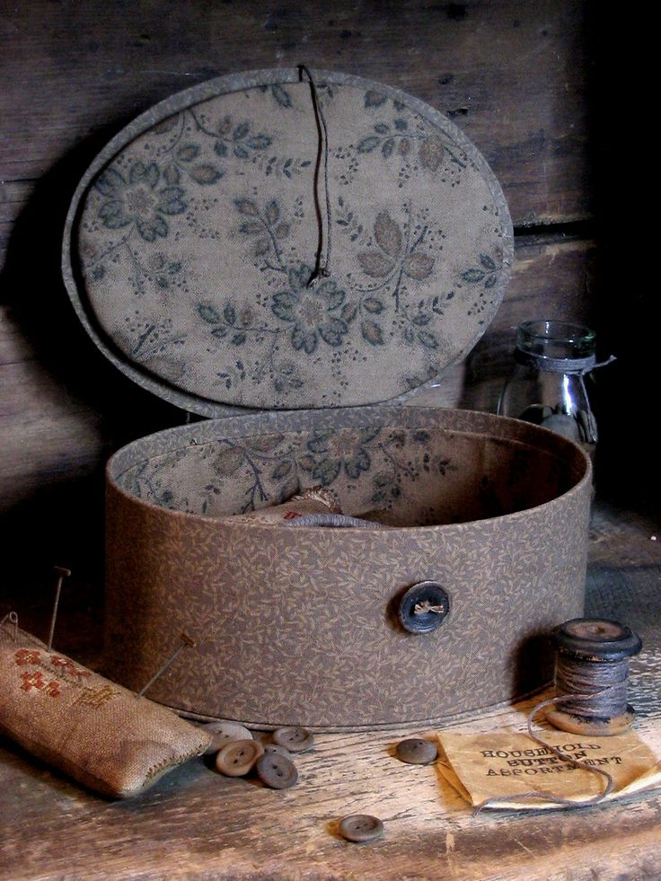

Slide 6
Production Needs
Rocking Chair
  Corner
  Window by it?
Stairs
Door at the top of the stairs
Door to interior room with closet
Door leading to the shed/outside
Iron stove
Table and chairs
Cupboard
Sink (water basin)
Set

Slide 7
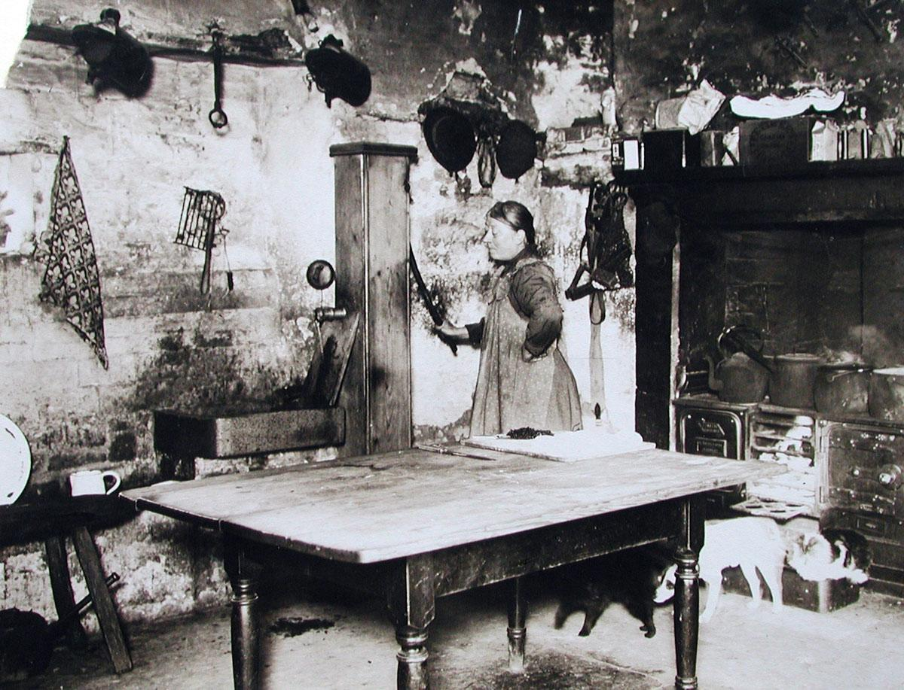
1910 farmhouse
Crowded and messy
Stove is a prominent feature
https://www.sulgrave.org/OLD%20SULGRAVE/Farming.html

Slide 8
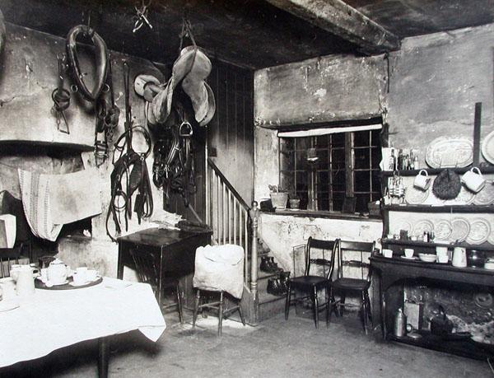
Staircase
Window
https://www.sulgrave.org/OLD%20SULGRAVE/Farming.html

Slide 9
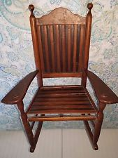
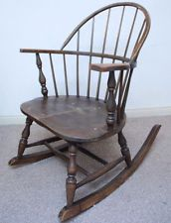

Slide 10
Production Needs
Notebook and pencil
Fruit (broken jars)
Dirty towels
Unwashed pans
Bread set and loaf
Cherries in a jar
Rag for the table
Sewing basket with quilt pieces
Bird cage with a broken door
Fancy box
Props

Slide 11
Production Needs
Winter apparel
Coat with large pockets for Mrs. Hale
Clothes to gather for Mrs. Wright
  Apron
  Shawl
Fur tippet for Mrs. Peters
Costumes

Slide 12
Production Needs
Squeaking rocking chair
Wind?
Footsteps above
Stove sounds
Sound

Slide 13
Production Needs
Gobo for window?
Dreary, cold
Long shadows - late afternoon
Lighting

Slide 14
Woman’s Honor
by Susan Glaspell

Slide 15
Thematic Statement
In Woman’s Honor by Susan Glaspell, Glaspell addresses the topic of woman’s honor; she demonstrates that woman’s honor is a concept, not a reality, that has so much unnecessary value placed on it, that it can be ridiculous at best, and ruin lives at worst.

Slide 16
Central Production Metaphor
Wallace is held prisoner because of it
Some women feel trapped by it
More and more women come as Wallace urges them to leave
Woman’s Honor is a straightjacket that tightens every time it is struggled against.

Slide 17
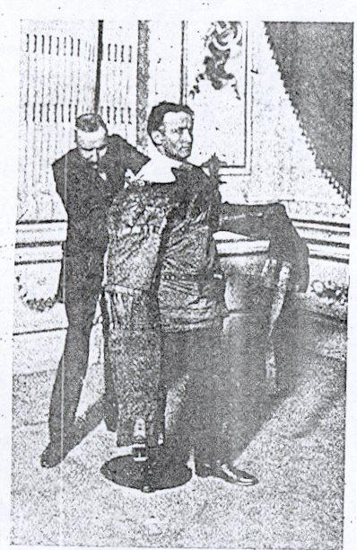
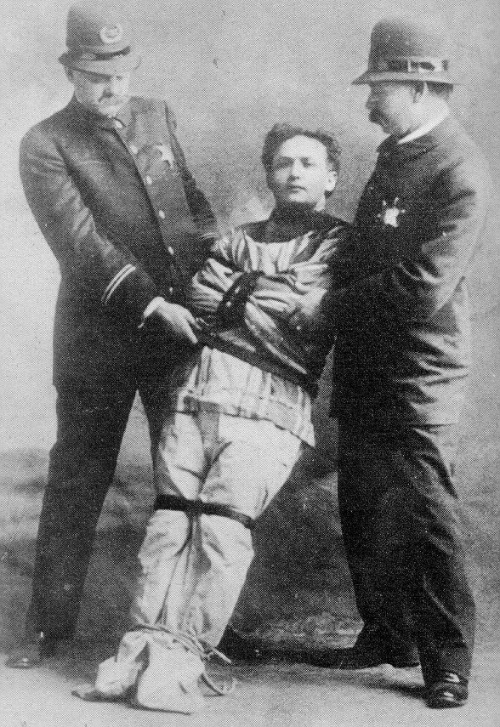
https://s-media-cache-ak0.pinimg.com/736x/8f/50/2d/8f502d1be8187f7468f25994ff40f431--harry-houdini-trap-door.jpg
Done willingly
http://www.hat-archive.com/houdin~3bsj.jpg

Slide 18
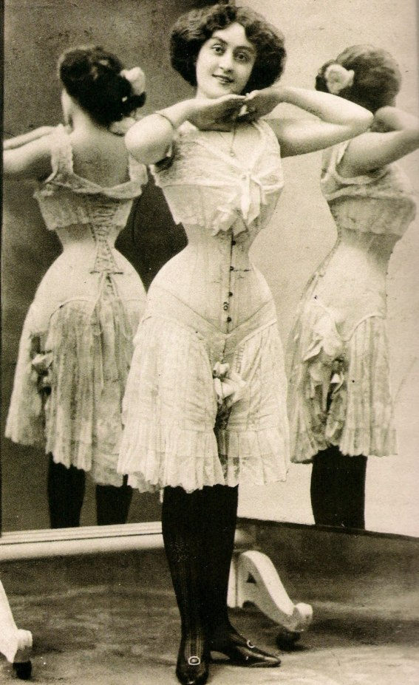
Corset, not a straightjacket
Woman’s honor is marketed the same way
The Silly One embraces it
http://www.stylehasnosize.com/2014/home/100-years-fashion-1910/

Slide 19
Production Needs
Chairs
Table?
Door at right
Door at rear
Door at left
Script does not call for much
  Room for creativity
Set

Slide 20
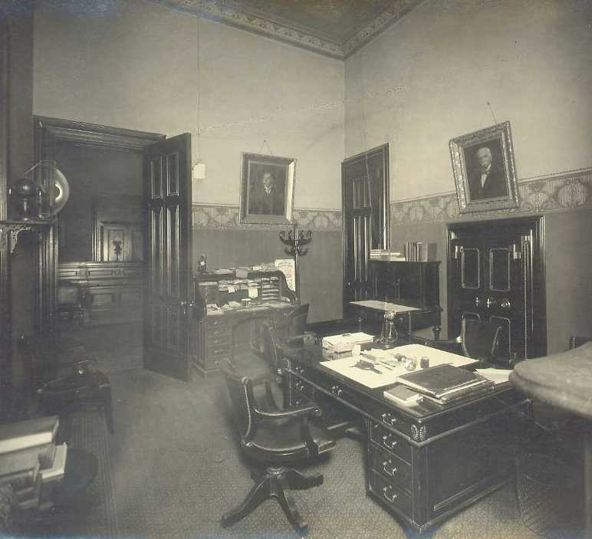
Room in a house
An office?
  Business-like
Some similar features to the Trifles set
  Three doors
https://www.officemuseum.com/IMagesWWW/1910_Phila_Bank_by_Wm_H_Rau_12.jpg

Slide 21
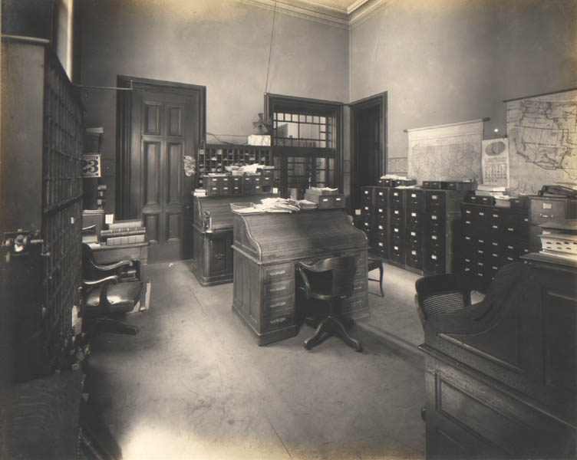
https://www.officemuseum.com/IMagesWWW/1910_Phila_Bank_by_Wm_H_Rau_6.jpg

Slide 22
Production Needs
Newspaper
Purses
Knitting
  Muffler
Props

Slide 23
Production Needs
Coats
  Late October/early November
Suits
Costumes

Slide 24
Production Needs
Squeaking door
Sound

Slide 25
Production Needs
Warm, bright
Sunlight through windows?
Late morning
Lighting

Slide 26
Production Challenges
Stairs
Doors
Changing from one set to another
  Pieces connection?

Slide 27
Thank you!

